Slide 1
Opening a Clothing Store in NYC
By: Scott Paz

Slide 2
Opening Clothing Stores is Important for any Owner that wants to Open Shop
The total value of the apparel market around the world is worth about 1.78 trillion dollars, where in the United States' stores are worth 368 billion dollars
Gucci alone brought in almost 270 million euros in revenue during the 2018 fiscal year
This should interest clothing companies that want to open up a physical store in New York City and want it to be in the most populated and busiest shopping areas

Slide 3
Business Problem
The client has a successful clothing business, where she does all her sales online. She wants to expand, make more money, and get her product out as much as possible, but she does not know where to start
Wants to do it in New York City, because that is where her company is based but she does not want to settle anywhere
She wants to have her first store to be open in a populated area surrounded by many other stores so people have more of a tendency to stop by her store

Slide 4
Data
https://en.wikipedia.org/wiki/Neighborhoods_in_New_York_City
This data set will provide population per neighborhood in New York City
Foursquare API
This data set will provide a list of all the stores are located in New York City, this will be an indication of popular foot traffic in each city/neighborhood in New York City
https://cocl.us/new_york_dataset
This specific data set pulls the latitude and longitude for each neighborhood in each borough

Slide 5
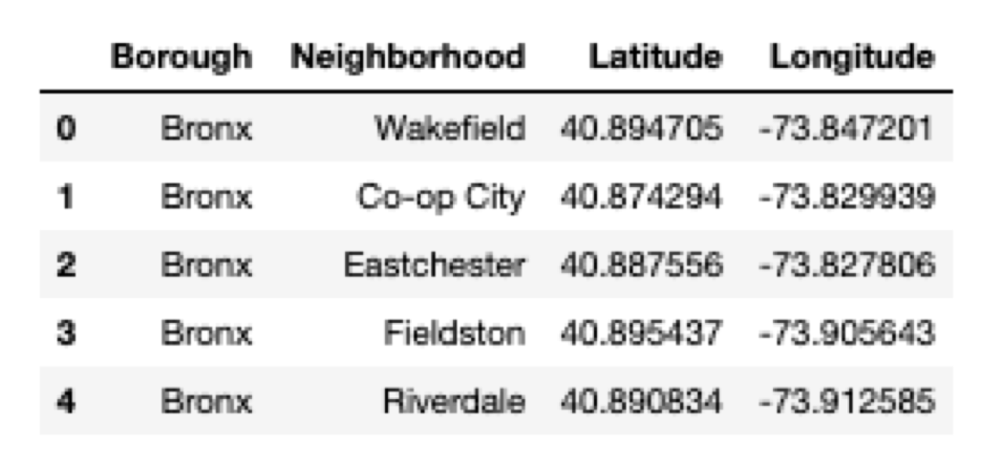
Methodology
Importing https://cocl.us/new_york_dataset this gives us Borough, Neighborhood, Latitude, and Longitude

Slide 6
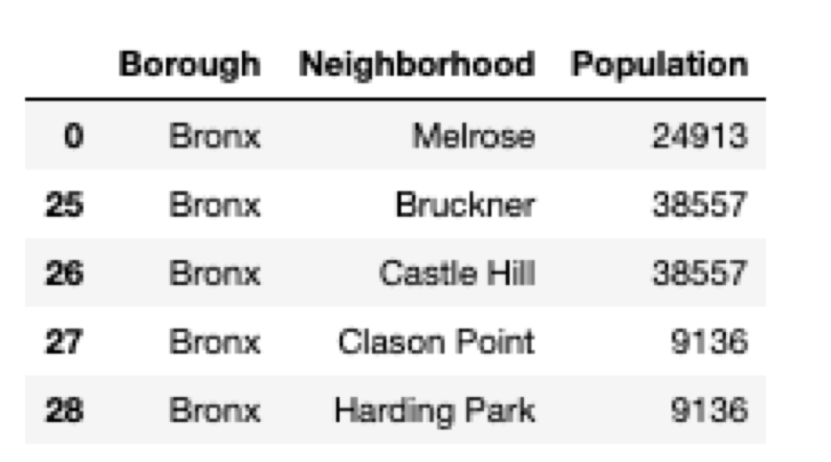
Methodology
Using Beautiful Soup, to call csv from Wikipedia page, this will give us the total population in each Neighborhood

Slide 7
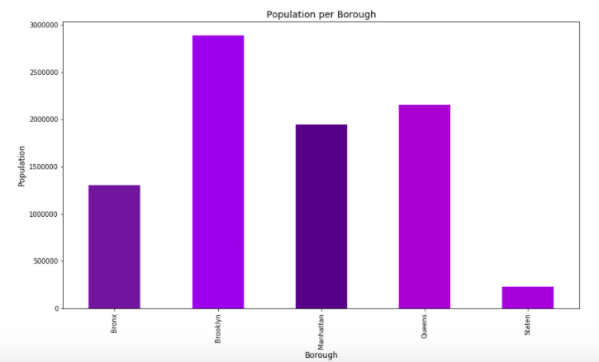
Methodology
Population per Borough
As can be seen, Brooklyn has the highest, then Manhattan, followed by Queens, second to last is the Bronx, and lastly is Staten Island

Slide 8
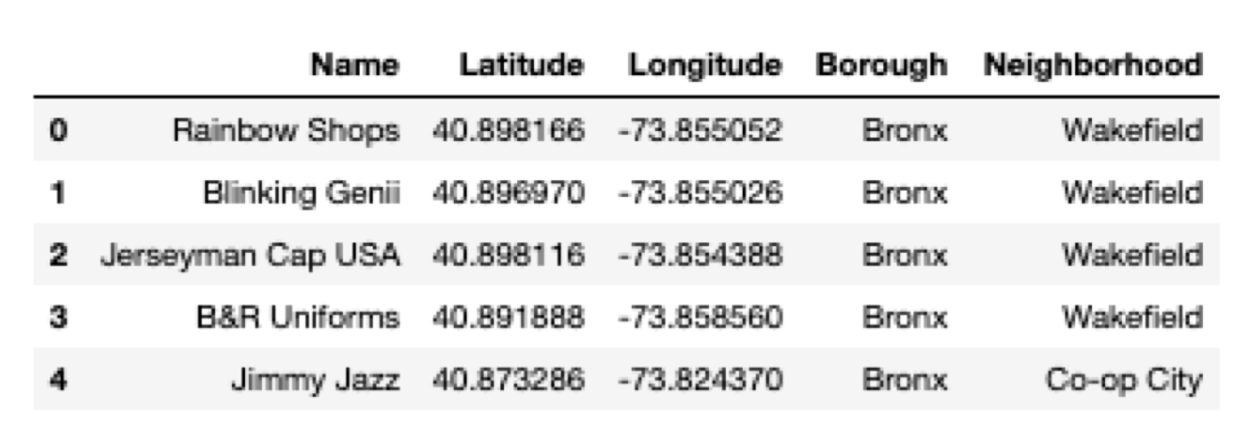
Methodology
Foursquare API
This pulls name of the shops, Latitude, Longitude, Borough, and Neighborhood

Slide 9
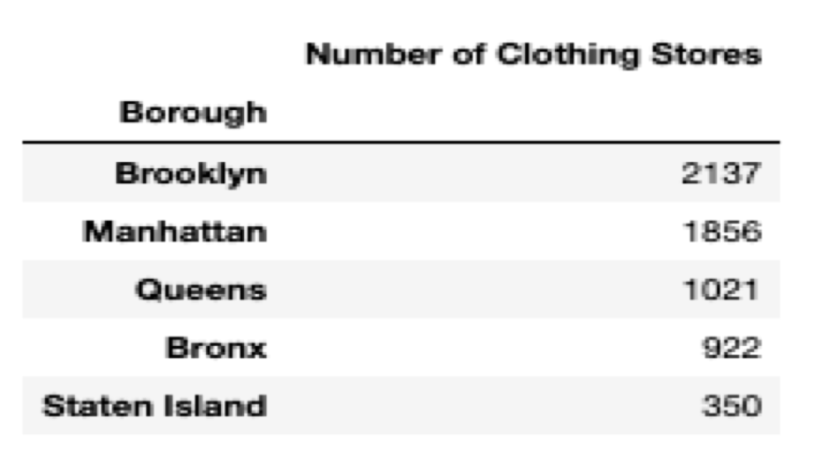
Methodology
Foursquare API dataframe continued, manipulated to return all stores in each Borough

Slide 10
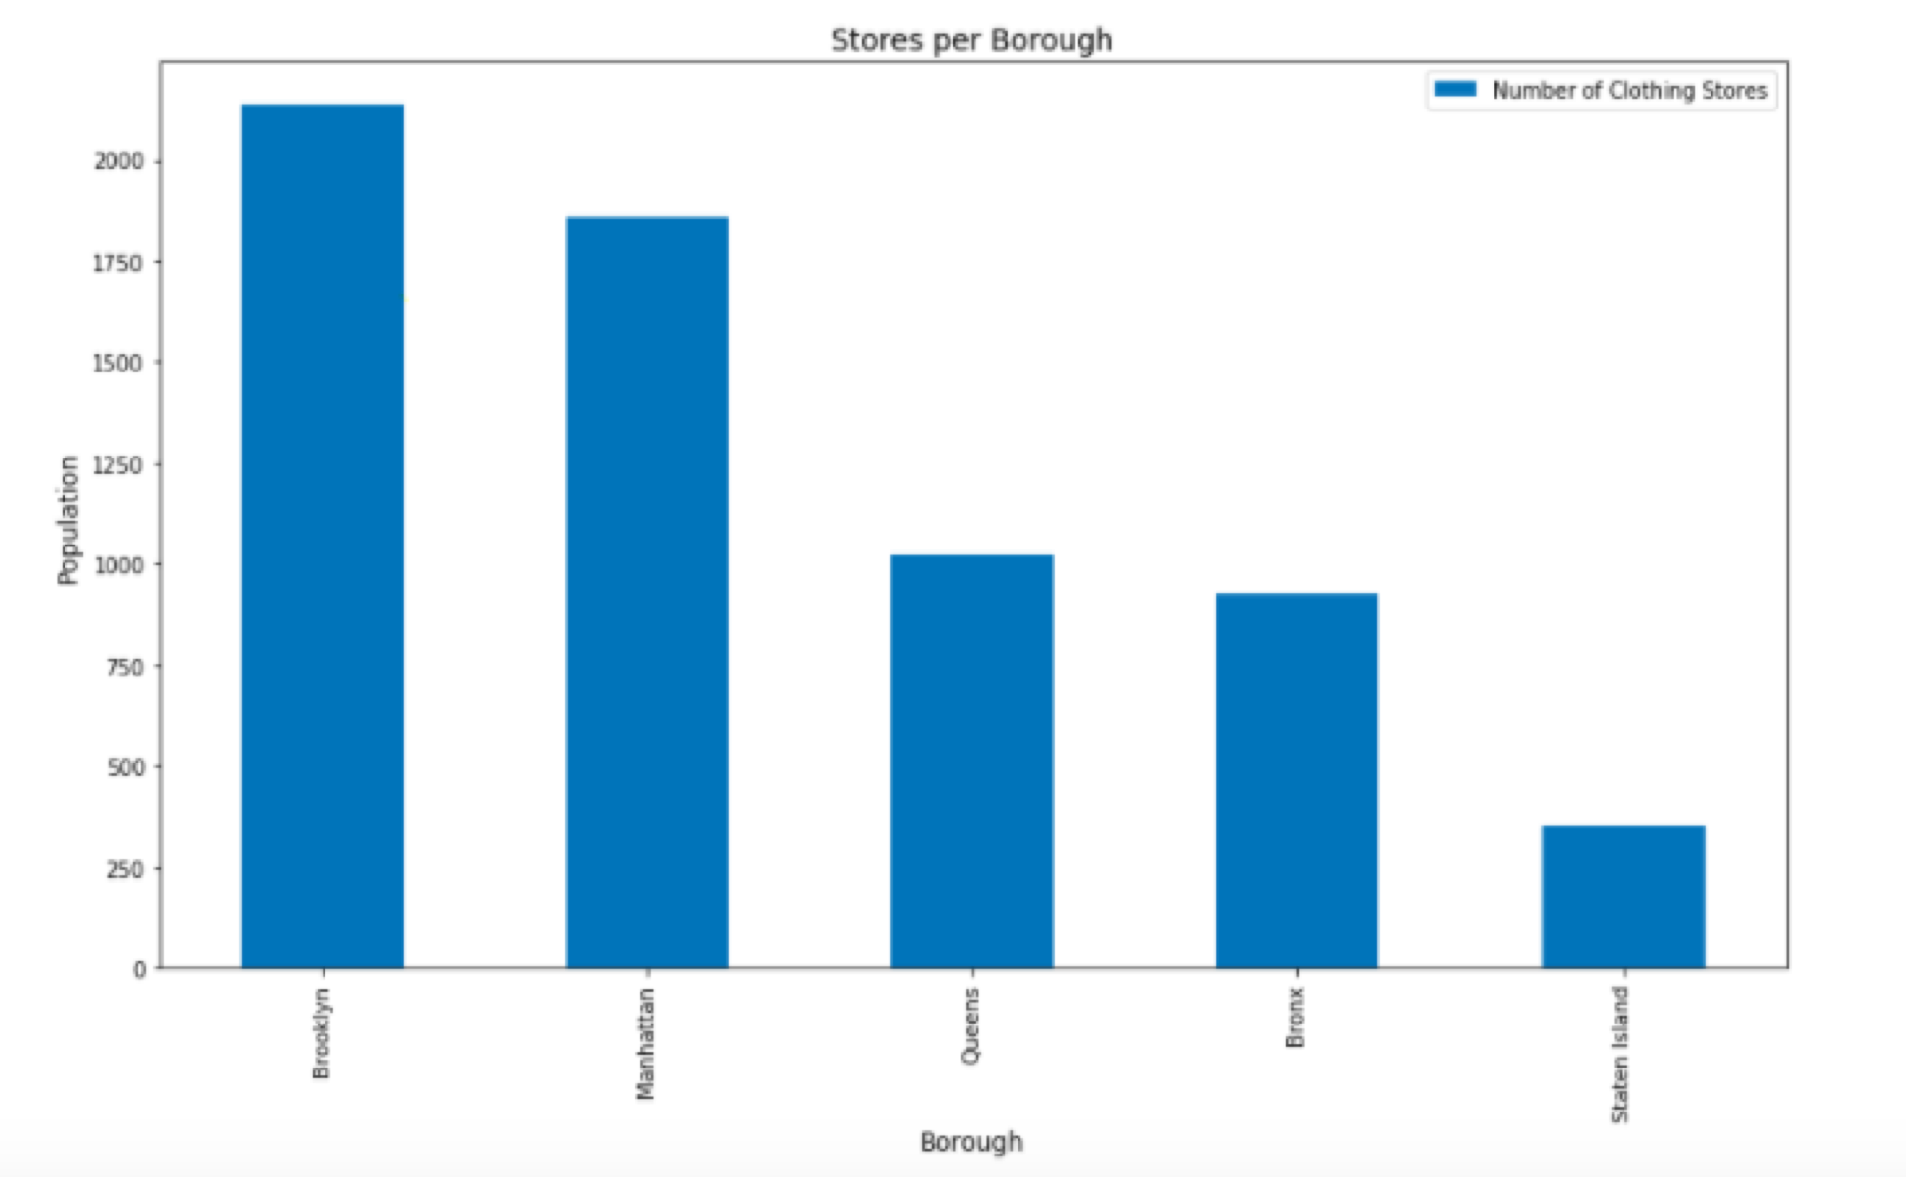
Methodology
Stores per Borough
Brooklyn
Manhattan
Queens
Bronx
Staten Island

Slide 11
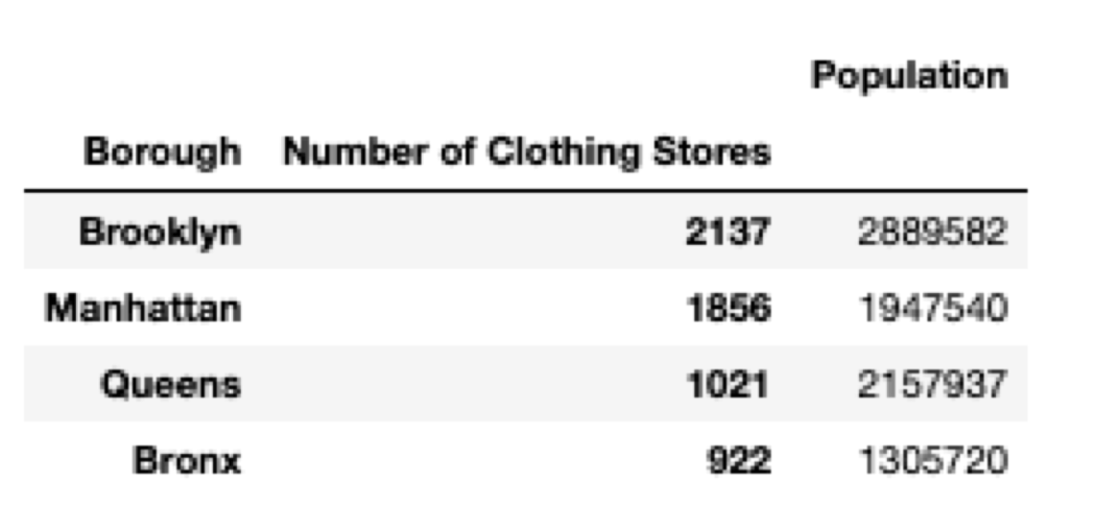
Results
The final results
As it can be seen Brooklyn has the most amount of clothing stores and the highest population
This means that the client should open her store in Brooklyn

Slide 12
Discussion
Some observations that were notice was first, Staten island did not have many stores and half the population of Bronx, so it was omitted in the final results table
Brooklyn would be the best fit for the client’s request
This is because it fills both her requests of the most popular retail stores and popularity
What if the wants of the Client were broken down more?
Specifically, what if the crime was taken into account? If crime was taken into account though it may get a bit trickier because crime rate in New York City does not separate their crime by neighborhood, it separates it by Borough and Precinct
But she would be in a safer area
Possibly taking into account rental space for each borough/neighborhood could be helpful as well for client

Slide 13
Conclusions
Able to analyze the population of each borough and how many stores are located in each borough
The graphs and information that were produced may be able to help people determine where they want their next retail store to be or store in general
Whether it is somewhere popular with a ton of stores such as Brooklyn, or a popular place with not that many stores such as the Queens

